Slide 1
Positioning Pyramid - B2C
Seafood/species from Norway
Blank version for filling in (English)

Slide 2

”Positioning pyramid” B2C – headings
Brand Promise
Projection
Relation / Role
Personality & Values
Supporting evidence
Competitive Advantage
Needs
Insight
Purchase & Consumption situations
Target Group
Competitive Arena

Slide 3

”Positioning pyramid” B2C
Competitive arena
How can we describe the position we aim to achieve, relative to competitors?

Slide 4

Competitive arena
…
Competitive arena
How can we describe the position we aim to achieve, relative to competitors?

Slide 5
”Positioning pyramid” B2C
Target Group
Who is our target group?

Slide 6
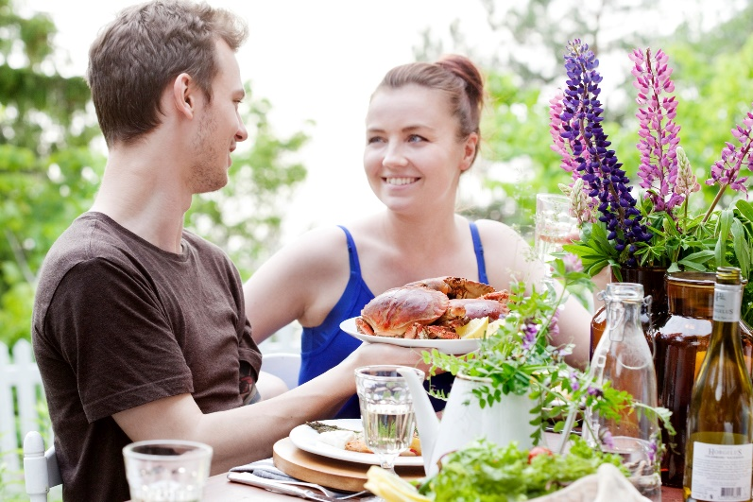
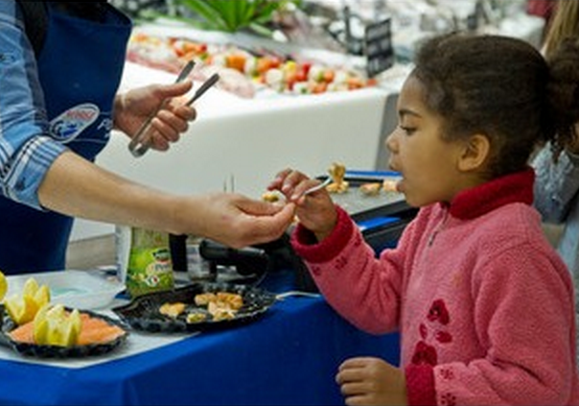
Key Strategic target group(s)
….
Target group(s)
What are the most important needs of the consumer connected with seafood/species from Norway?

Slide 7
”Positioning pyramid” B2C
Purchase & Consumption situations
What are the most important purchase and consumption situations for our consumers?

Slide 8
urchase and consumption situations
P
…
Purchase & Consumption situations
What are the most important purchase and consumption situations for our consumers?

Slide 9
”Positioning pyramid” B2C
Insights
Which insights do we have about the target groups in the most important purchase and consumption situations?

Slide 10

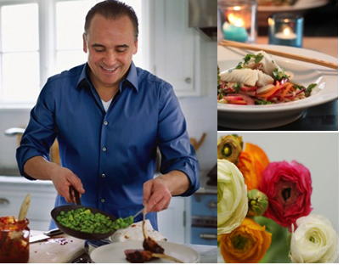
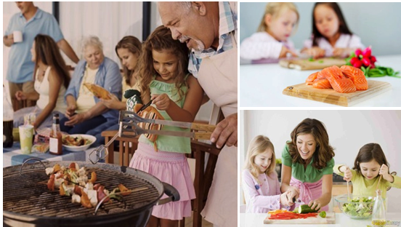
Insight
Insight – Target Group A:
…..
Insight – Target Group B:
….
Insights
Which insights do we have about the target groups in the most important purchase and consumption situations?

Slide 11
”Positioning pyramid” B2C
Needs
What are the most important needs of the consumer connected with seafood from Norway?

Slide 12
Needs
Target Group needs:
Emotional: …
Sensory: ….
Functional: ….
Needs
What are the most important needs of the consumer connected with seafood/species from Norway?

Slide 13

”Positioning pyramid” B2C
Competitive Advantage
What unique benefit do we primarily offer the target group (explisit or implisit) today?

Slide 14

Competitive advantage
…
Competitive Advantage
What unique benefit do we primarily offer the target group (explisit or implisit) today?

Slide 15
”Positioning pyramid” B2C
Supporting evidence
What is the supporting evidence / reason to believe for the the target groups?

Slide 16
Supporting evidence/REAson to beleive
…...
Supporting evidence/Reason to believe
What is the supporting evidence / reason to believe for the target group(s)?
Notes:
Our three pillars-the brand equity

Slide 17

”Positioning pyramid” B2C
Personality & Values
How can we describe seafood from Norway in terms of personality and key values?

Slide 18
Personality and values
Personality:
….
Values:
…..
Personality & Values
How can we describe seafood/species from Norway in terms of personality and key values?

Slide 19
”Positioning pyramid” B2C
Relation to/Role
What role does seafood from Norway have in the life of our consumers? What kind of relationship do we want the consumers to have with seafood from Norway?

Slide 20
R
elation to/ role of
…
Relation to/Role
What role does seafood/species from Norway have in the life of our consumers? What kind of relationship do we want the consumers to have with seafood/species from Norway?
Notes:
One you respect and admire

Slide 21
”Positioning pyramid” B2C
Projection
How will others describe the consumer of seafood from Norway? How are our consumers perceived by others?

Slide 22
P
rojection
…
How would others describe the use of seafood from Norway?
What does seafood from Norway tell my surroundings about me as a consumer and person?
Projection
How will others describe the consumer of seafood/species from Norway? How are our consumers perceived by others?

Slide 23
”Positioning pyramid” B2C
Brand Promise
How can the essence of seafood from Norway be described? What is the summary of the position for seafood from Norway?

Slide 24
Brand promise –
xx
Brand Promise
How can the essence of seafood/species from Norway be described? What is the summary of the position for seafood/species from Norway?
Notes:
To some extent, it’s a mission; it’s how the company creates and delivers value. Also, it’s the feeling the company conveys to its stakeholders
A strong brand promise is one that connects your purpose, your positioning, your strategy, your people and your customer experience. It enables you to deliver your brand in a way that connects emotionally with your customers and differentiates your brand.

